Slide 1
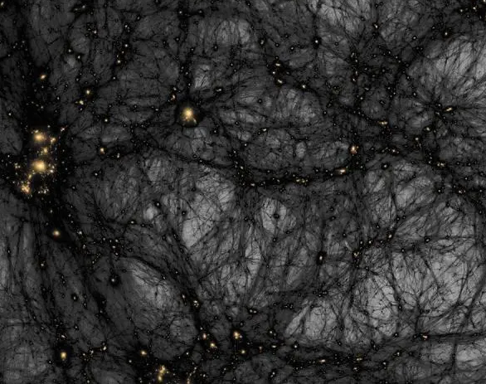
Dark Matter Searches

Slide 2
Pg 2, sl 33, 34, pg 3, 4, 5

Slide 3
Dark matter candidates (pg 6,7,8,9)

Slide 4
Ways of detection (pg 10, 11)

Slide 5
DD (Chris Savage pg 27-35)

Slide 6
Collider Searches (Baltic school 20-25)

Slide 7
Indirect searches - neutrinos (scott pg2, 13, 44, 14)

Slide 8
Gamma rays (scott pg 22, dinieto pg 19, 6, 7, 8,9 )

Slide 9
Thank You!

